Slide 1
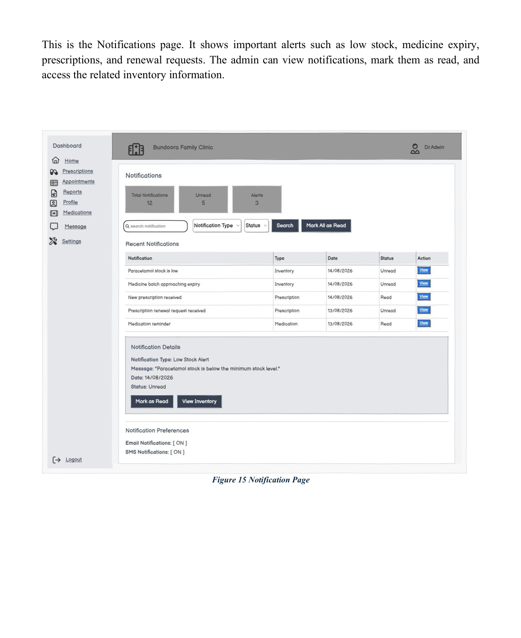
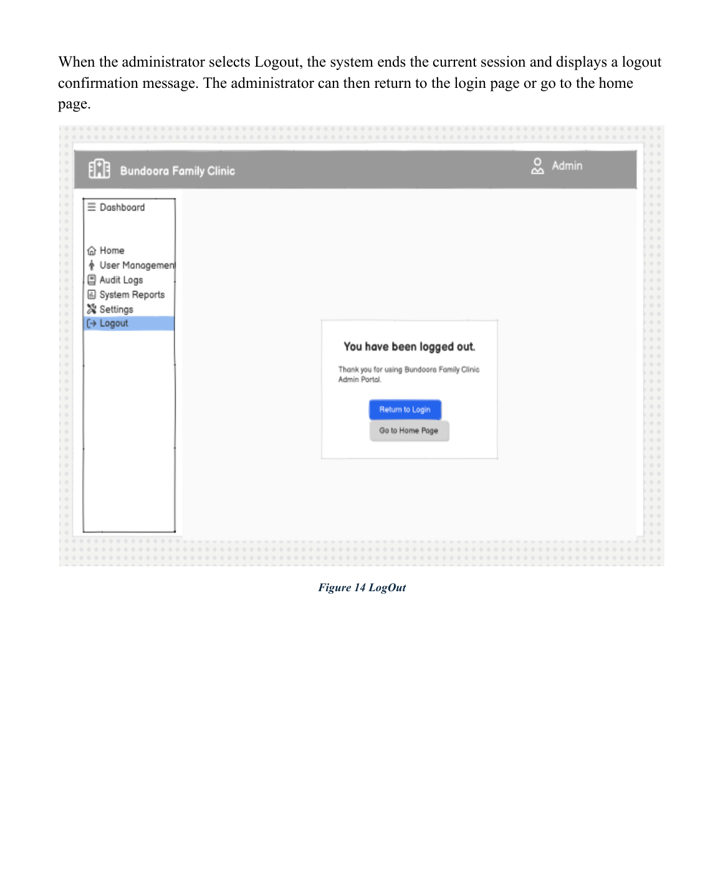
UI Showcase — Notifications
UI / ADMIN
Role-based interface screens reproduced from the final SRS report.
Figure/page Notifications
Presenter: Yam Bahadur Mohatra • Student ID: K230505
21

Slide 2
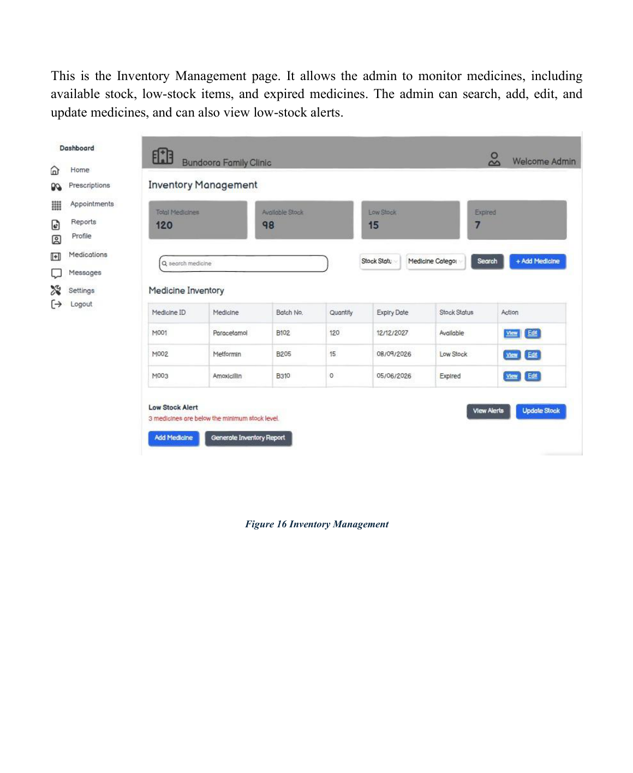
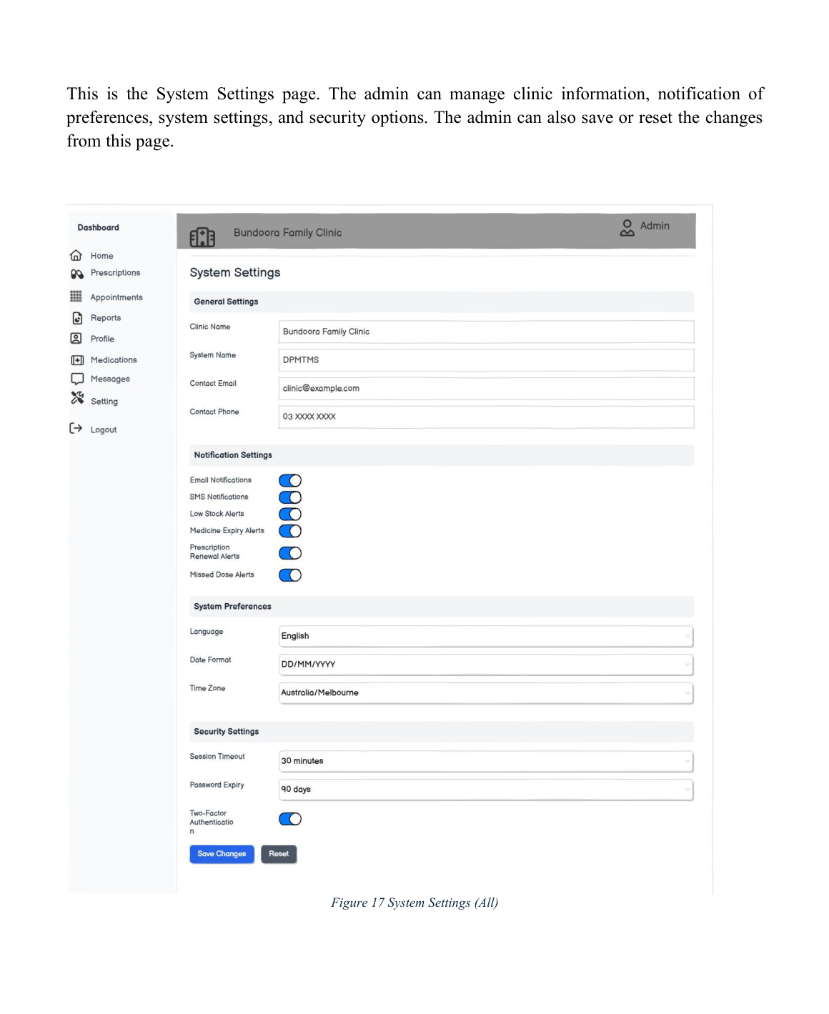
UI Showcase — Inventory Management & System Settings
UI / ADMIN
Role-based interface screens reproduced from the final SRS report.
Figure/page Inventory Management
Figure/page System Settings
Presenter: Yam Bahadur Mohatra • Student ID: K230505
22

Slide 3
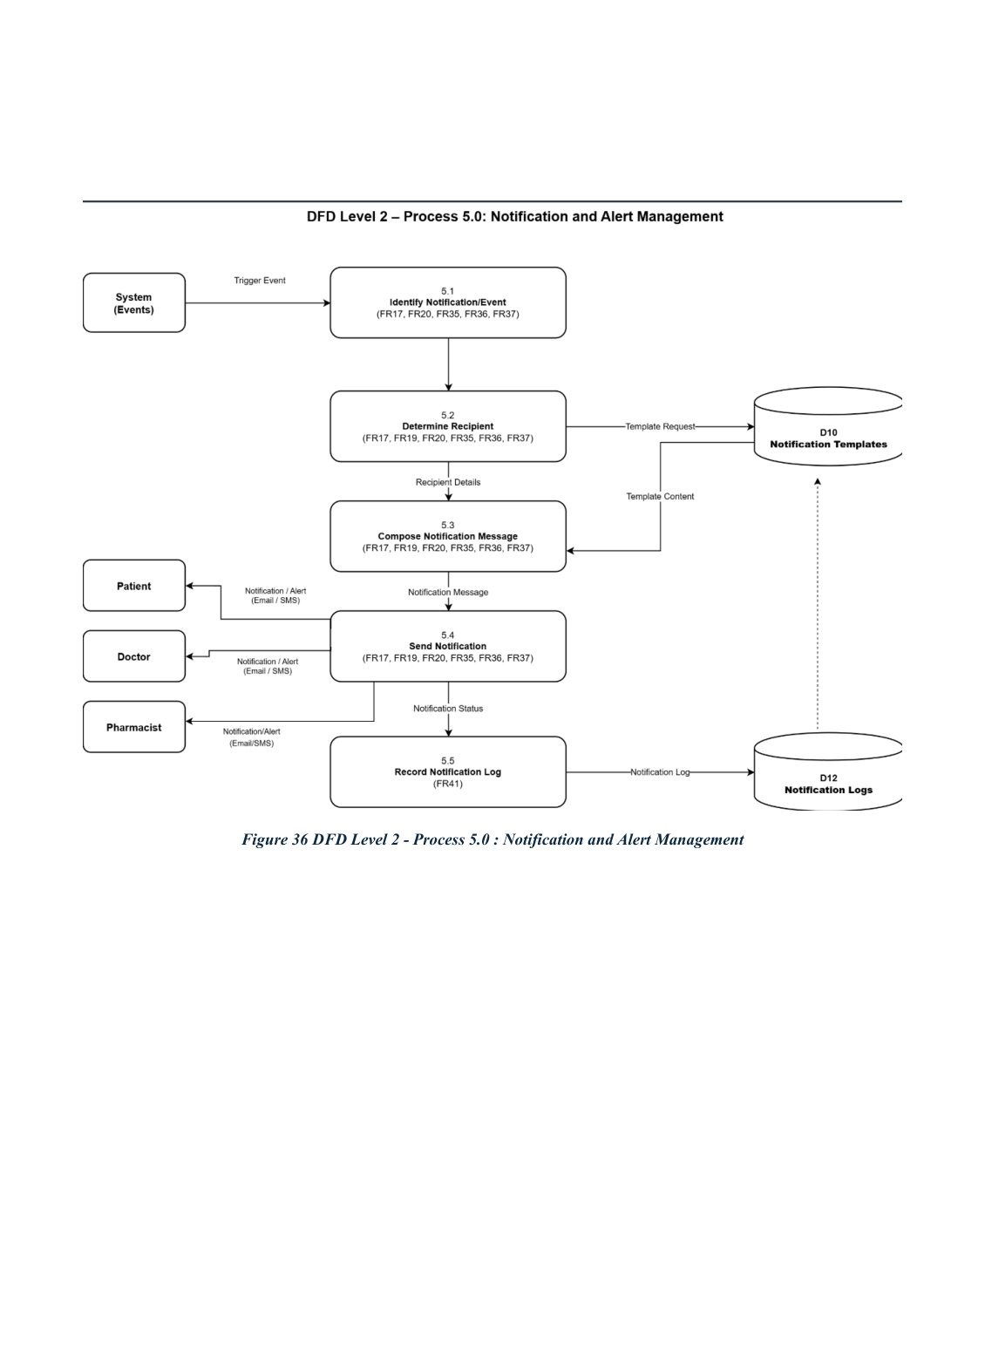
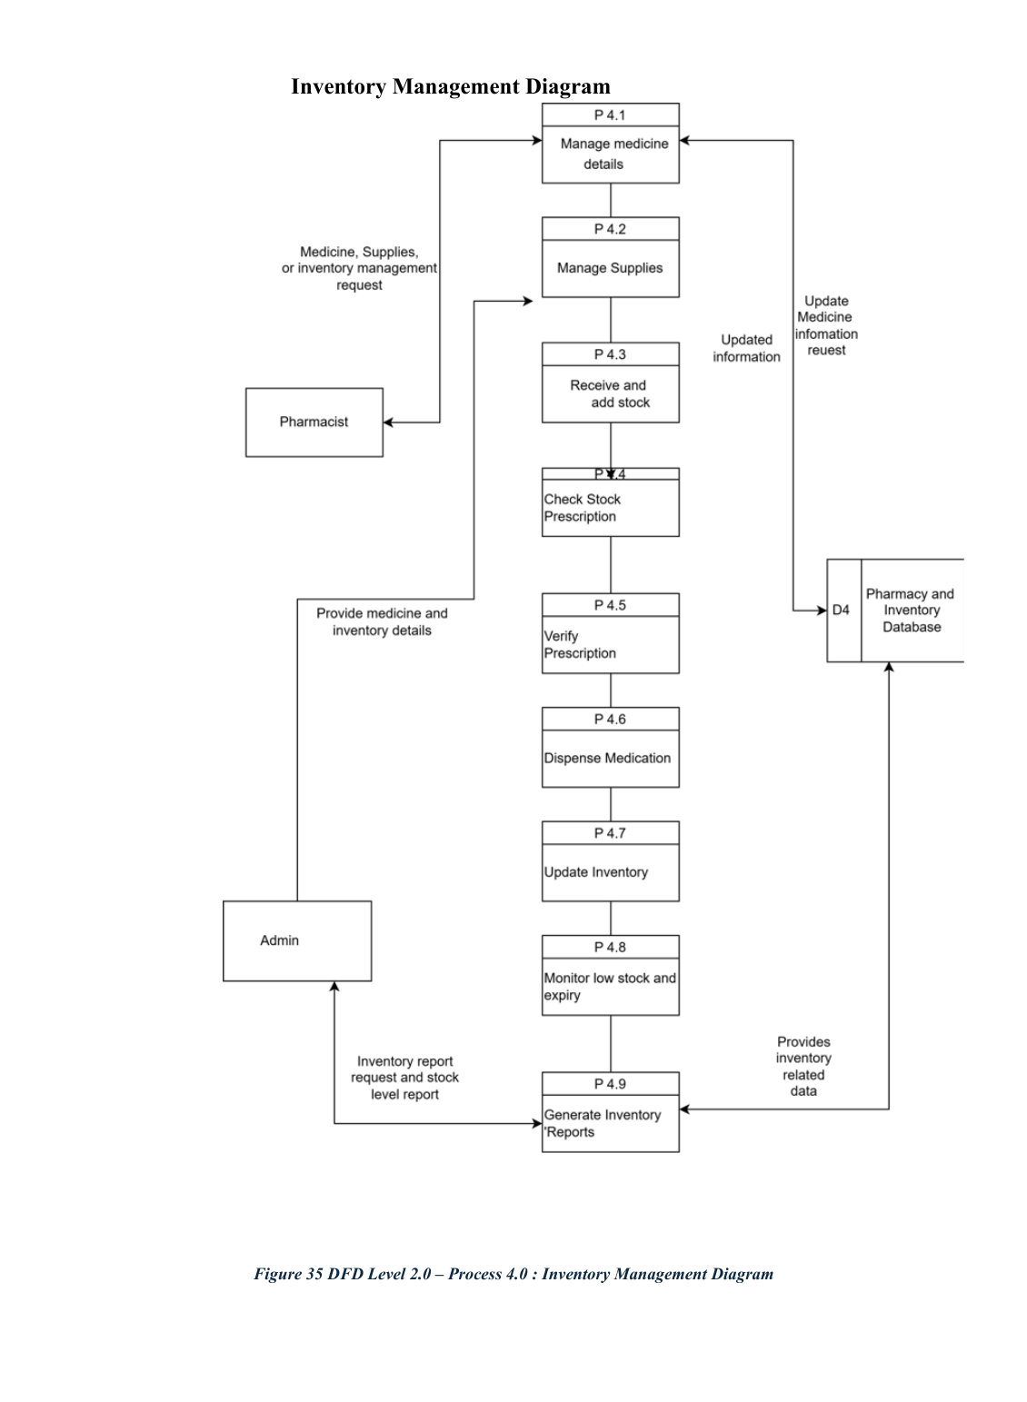
DFD Level 2 — Process 5: Notifications
SYSTEM MODELS
Process 5.0 manages alerts and notifications.
Presenter: Yam Bahadur Mohatra • Student ID: K230505
34

Slide 4
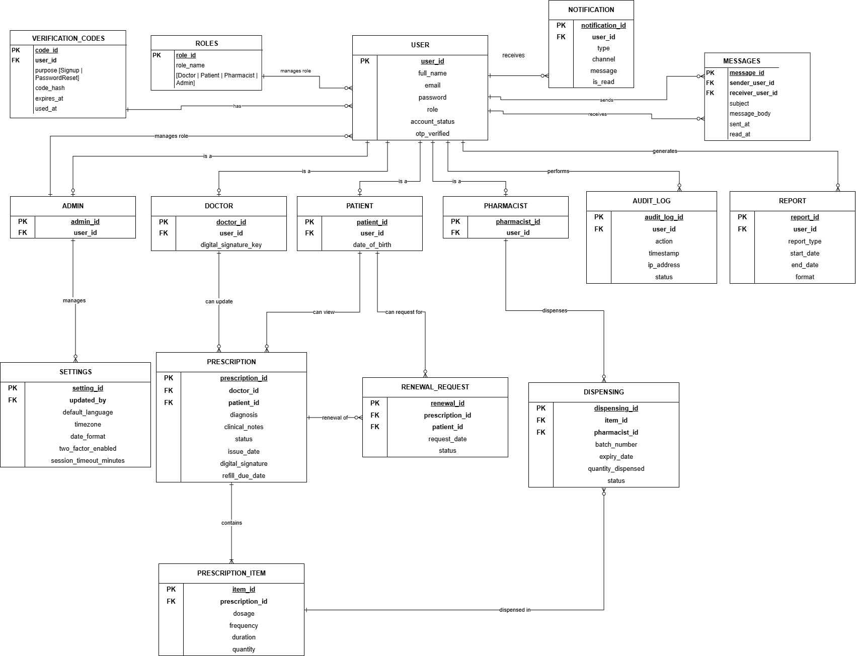
Entity Relationship Diagram (ERD)
DATA DESIGN
Central database relationships for users, prescriptions, medicines, inventory, dispensing, tracking, notifications and audit.
Presenter: Yam Bahadur Mohatra • Student ID: K230505
37

Slide 5
System Development Methodology — Agile
DEVELOPMENT
Agile is selected because the project benefits from iterative delivery, stakeholder feedback and flexibility.
Why Agile
Core cycle
Project focus
Six-month development period, continuous stakeholder involvement, early feedback and flexibility for evolving features.
Planning → Design → Development → Testing → Review & Feedback → Deployment.
Digital prescriptions, inventory tracking, AI decision support, RBAC and automated notifications.
Planning defines priorities, scope, roles and responsibilities.
Design emphasizes functional requirements, 3NF database design and MVC architecture.
Development builds the modules; testing validates functionality, usability and security.
Review/feedback refines the next iteration; deployment addresses risks and scope changes.
Presenter: Yam Bahadur Mohatra • Student ID: K230505
42

Slide 6
Supervisor Feedback & Project Traceability
PROJECT MANAGEMENT
The final SRS documents feedback, actions taken and evidence of completion.
Feedback documentation
Repository evidence
Issue closure
A structured table records significant supervisor feedback, group action and outcome/justification.
Completed work is uploaded/committed to the project repository before moving the corresponding task to Done.
After completion and repository verification, the corresponding issue is closed to maintain a consistent audit trail.
The response process improves traceability between task allocation, completed work, repository evidence and issue closure.
The report includes screenshots as supporting evidence of supervisor instructions and feedback.
Presenter: Yam Bahadur Mohatra • Student ID: K230505
45

